Slide 1
AVL-Trees
(Adelson-Velskii and Landis-Trees)

Slide 2
Balanced binary tree
The disadvantage of a binary search tree is that its height can be as large as N-1
This means that the time needed to perform insertion and deletion and many other operations can be O(N) in the worst case
We want a tree with small height
A binary tree with N node has height at least Θ(log N)
Thus, our goal is to keep the height of a binary search tree O(log N)
Such trees are called balanced binary search trees. Examples are AVL tree, red-black tree.

Slide 3
AVL tree
Height of a node
The height of a leaf is 0. The height of an empty tree is -1.
The height of an internal node is the maximum height of its children plus 1

Slide 4
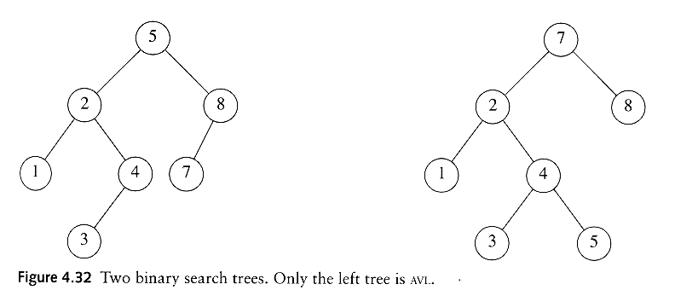
AVL tree
An AVL tree is a binary search tree in which
  for every node in the tree, the height of the left and right subtrees differ by at most 1.
AVL property violated here

Slide 5
AVL tree
Let x be the root of an AVL tree of height h
Let S(h) denote the minimum number of nodes in an AVL tree of height h.
S(h)=S(h-1)+S(h-2)+1
Many operations (searching, insertion, deletion) on an AVL tree will take O(log N) time.

Slide 6
Rotations
When the tree structure changes (e.g., insertion or deletion), we need to transform the tree to restore the AVL tree property.
This is done using single rotations or double rotations.
e.g. Single Rotation
y
x
x
y
C
A
C
B
B
A
Before Rotation
After Rotation

Slide 7
Rotations
Since an insertion/deletion involves adding/deleting a single node, this can only increase/decrease the height of some subtree by 1
Thus, if the AVL tree property is violated at a node x, it means that the heights of left(x) and right(x) differ by exactly 2.
Rotations will be applied to x to restore the AVL tree property.

Slide 8
Insertion
First, insert the new key as a new leaf just as in ordinary binary search tree
Then trace the path from the new leaf towards the root. For each node x encountered, check if heights of left(x) and right(x) differ by at most 1.
If yes, proceed to parent(x). If not, restructure by doing either a single rotation or a double rotation
For insertion, once we perform a rotation at a node x, we don’t need to perform any rotation at any ancestor of x.

Slide 9
Insertion
Let x be the node at which left(x) and right(x) differ by more than 1
A violation may occur in four cases:
1. An insertion into the left subtree of the left child of x
2. An insertion into the right subtree of the left child of x
3. An insertion into the left subtree of the right child of x.
4. An insertion into the right subtree of the right child of x.

Slide 10
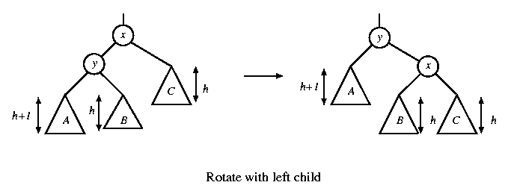
Single rotation
The new key is inserted in the subtree A.
The AVL-property is violated at x
height of left(x) is h+2
height of right(x) is h.

Slide 11
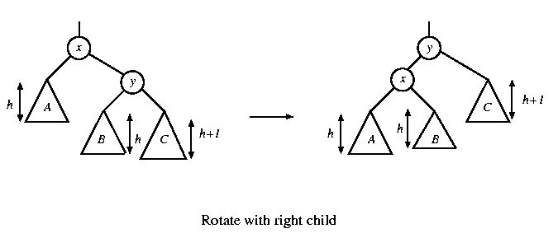
Single rotation
The new key is inserted in the subtree C.
The AVL-property is violated at x.
Single rotation takes O(1) time.
Insertion takes O(log N) time.

Slide 12
x
AVL Tree
5
5
y
8
C
3
3
8
1
4
B
1
4
A
0.8
Insert 0.8
3
5
1
After rotation
4
8
0.8

Slide 13
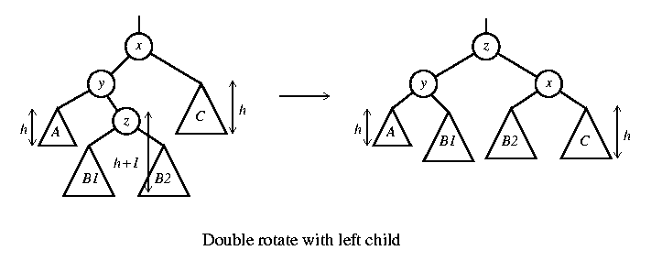
Double rotation
The new key is inserted in the subtree B1 or B2.
The AVL-property is violated at x.
x-y-z forms a zig-zag shape
also called left-right rotate

Slide 14
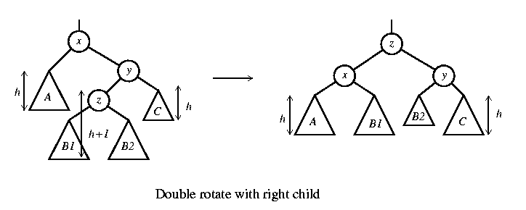
Double rotation
The new key is inserted in the subtree B1 or B2.
The AVL-property is violated at x.
also called right-left rotate

Slide 15
x
5
AVL Tree
5
C
y
8
3
3
8
A
1
4
z
1
4
B
3.5
Insert 3.5
4
5
3
3.5
8
After Rotation
1

Slide 16
An Extended Example
Insert 3,2,1,4,5,6,7, 16,15,14
Single rotation
3
2
3
3
2
1
Fig 1
2
3
Fig 4
Fig 2
2
1
2
Single rotation
Fig 3
1
1
3
3
Fig 5
Fig 6
4
4
5

Slide 17
2
2
Single rotation
1
4
1
4
3
5
3
5
Fig 8
Fig 7
6
4
4
Single rotation
2
5
2
5
1
3
6
1
3
6
4
Fig 9
Fig 10
7
2
6
1
3
7
5
Fig 11

Slide 18
4
2
6
1
3
7
5
16
Fig 12
4
Double rotation
4
2
6
2
6
1
3
7
1
3
15
5
16
5
16
Fig 13
7
15
Fig 14

Slide 19
4
4
Double rotation
2
6
2
7
15
1
3
15
1
3
5
6
16
7
5
14
16
Fig 15
14
Fig 16

